Slide 1
Model-driven optimization of tensor computations
Rui Li, Phd defense
Notes:
Thanks Saday, thanks committe, audience
today i am going to present the research

Slide 2
motivation
Tensor computation: core workloads of scientific computing & deep learning
Tensor contraction: computational chemistry, transformer
Convolution: convolutional neural networks
LU factorization: computational physics, circuit simulators
Key in performance optimization
Performance limited by communicating data: memory bound
Optimization techniques: loop tiling and reordering
Notes:
as we know the tensor computation is widely used in..
they appear every where in
the performance of .. is usually limited by accessing data, which means
the key technique is..
we will use a concrete example to show the basic concept of ..

Slide 3
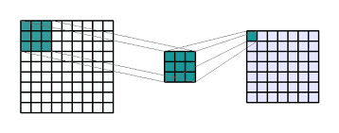
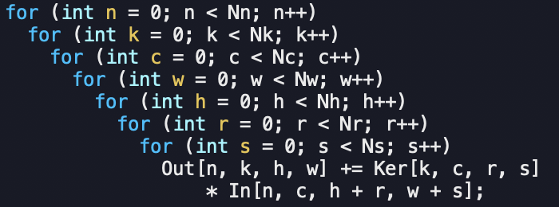
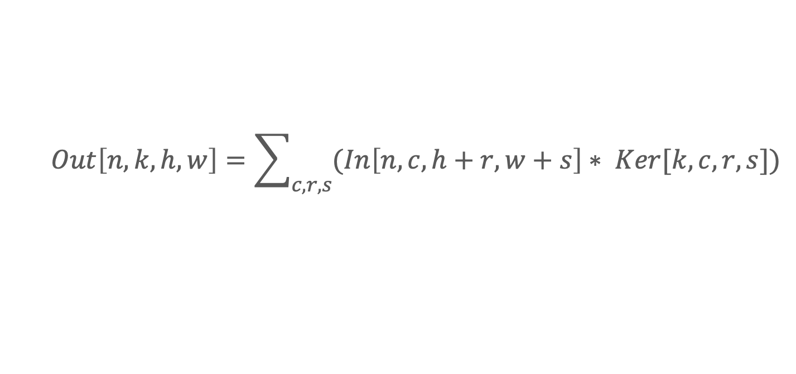
CNN Example - Naive
$$Out\left[n,k,h,w\right]=\sum_{c,r,s}{(In\left[n,c,h+r,w+s\right]∗ Ker[k,c,r,s}])$$
S
W
W
R
S
R
H
H
Ker
In
Out
Notes:
Here we presents the convolution computation, this is used as the conv layer in CNN. The simpliest way of impl this is to write the following 7d
if we do loop tiling on the top loop,

Slide 4
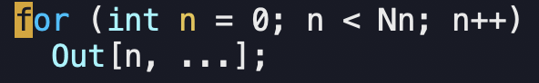
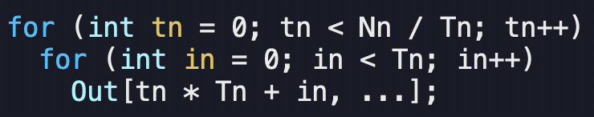
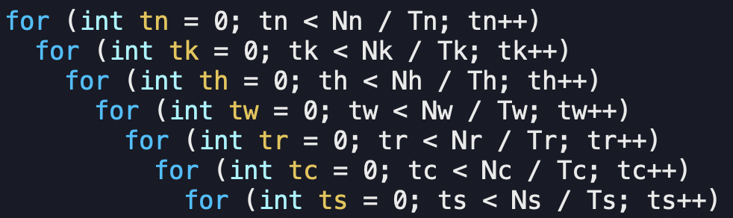
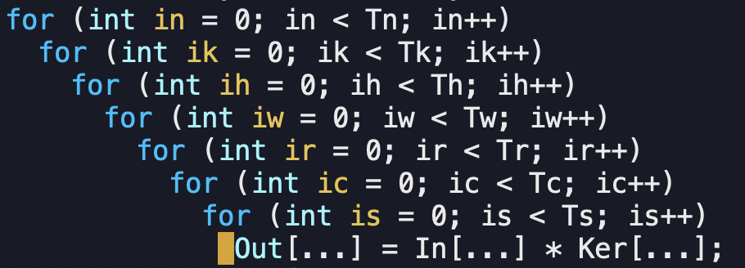
CNN EXAMPLE – 1 level of tiling
Tiling: divide single loop into two
1-level tiling: tile each loop once
What is design space of 1-level tiling?
7!(#tiling loop order) x #(T var options)
Tiling loops:
Loop order defines
schedule of tiles
Point loops:
Rectangular slice,
size bounded by T var
Notes:
it will sepreate the ori loop n into two loops, the outer loop tn and inner loop in. We call ..as tiling loop , .. as point loop. Now if we tile each loop once, we'll get 14d. we call this optimization as 1-lv tiling.
If we collect all point loops at bottom, and collect...
we noticed the iterating space of point loops constructs a hyper-rectangular slice, and the loop order of the tiling loops will decide the schedule of those slices.
if we change the range of pointloop, or if we change the tiling loop order, we'll get a different 1-lv tiling code.
In order to figure out which is best, straight way.. leads to Question
We can extend the calculation to be more general

Slide 5
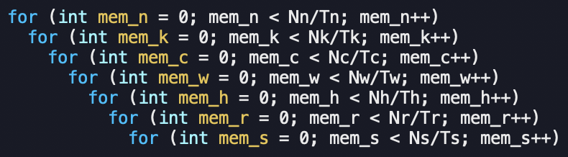
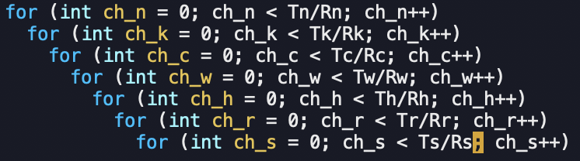
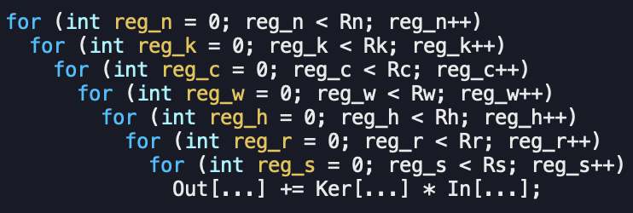
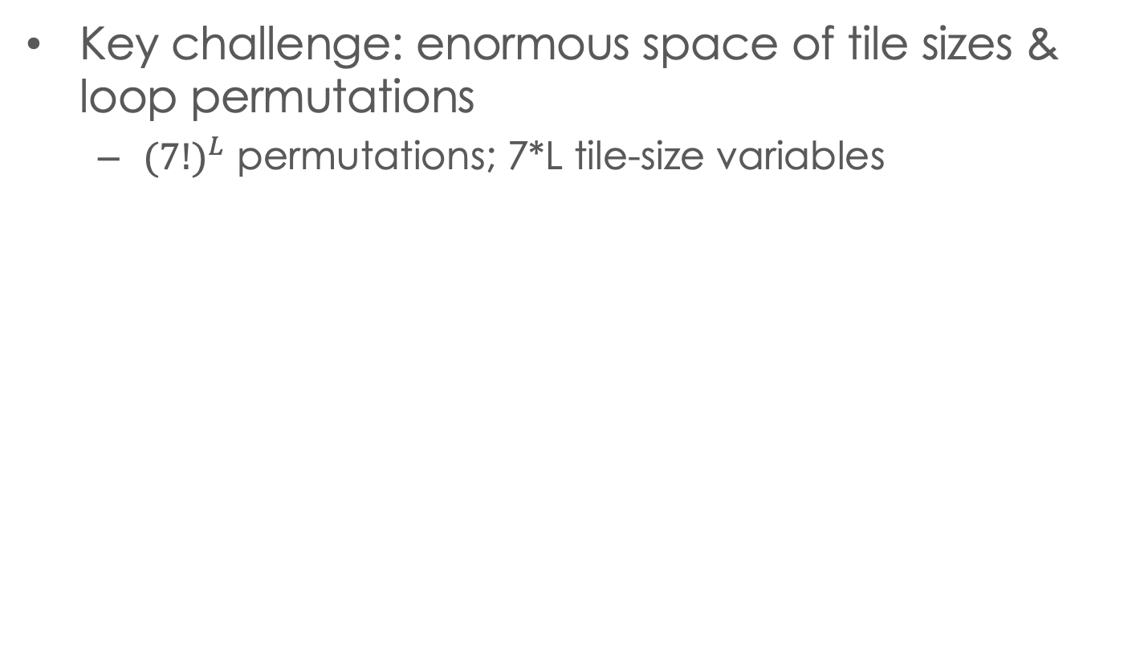
Design Space for multi-level Tiled CNN
Key challenge: enormous space of tile sizes & loop permutations
${(7!)}^{L}$ permutations; 7*L tile-size variables
Memory
7! Permutations
7 tile-size vars
Data movement
Loop order & tile-sizes determine data movement volume between memory and cache
Cache
7! Permutations
7 tile-size vars
Data movement
Loop order & tile-sizes determine data movement volume between cache and register
register
Notes:
Assume we have the following 2-lv vertical memory, and we do 1lv tiling for each memory level. We will have the following 2lv tiling code with 14d.
What is design space?
...
In conclusion, if we have L-lv vertical memory, ...
This large design space becomes the key challenge of finding the efficient multi-lv tiling code

Slide 6
optimizing tensor computation
Key challenge: enormous space of tile sizes & loop permutations
Existing approaches either search a limited design space and/or use very simple cost models
Vendor libraries: oneDNN(MKL)
Autotuning: AutoTVM
Polyhedral compiler optimization
We show that comprehensive exploration of the full design space of tile permutations and tile sizes using an effective cost model is feasible
We automatically derive the tile permutations & sizes and generate high-performance code
Notes:
There have been multiple prior works to optimize computations by using tiling, for example hpc lib, autotune compiler, poly compiler. But all of the .. ends with limited exploration.
In this research, we show ...
and moreover

Slide 7
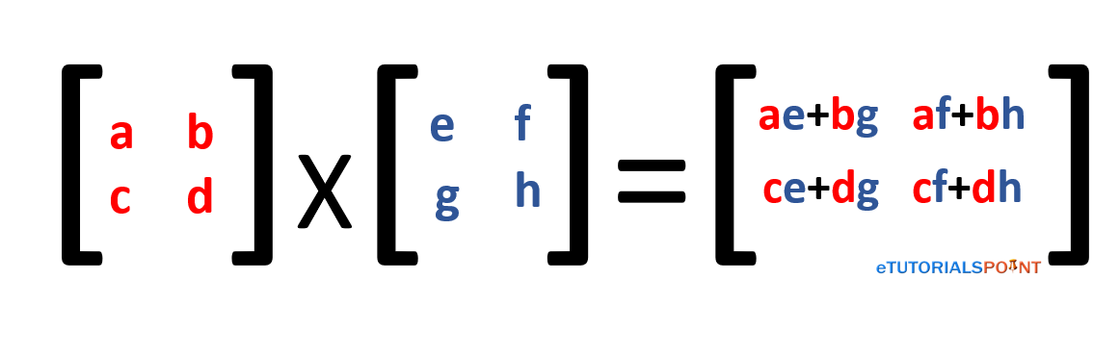
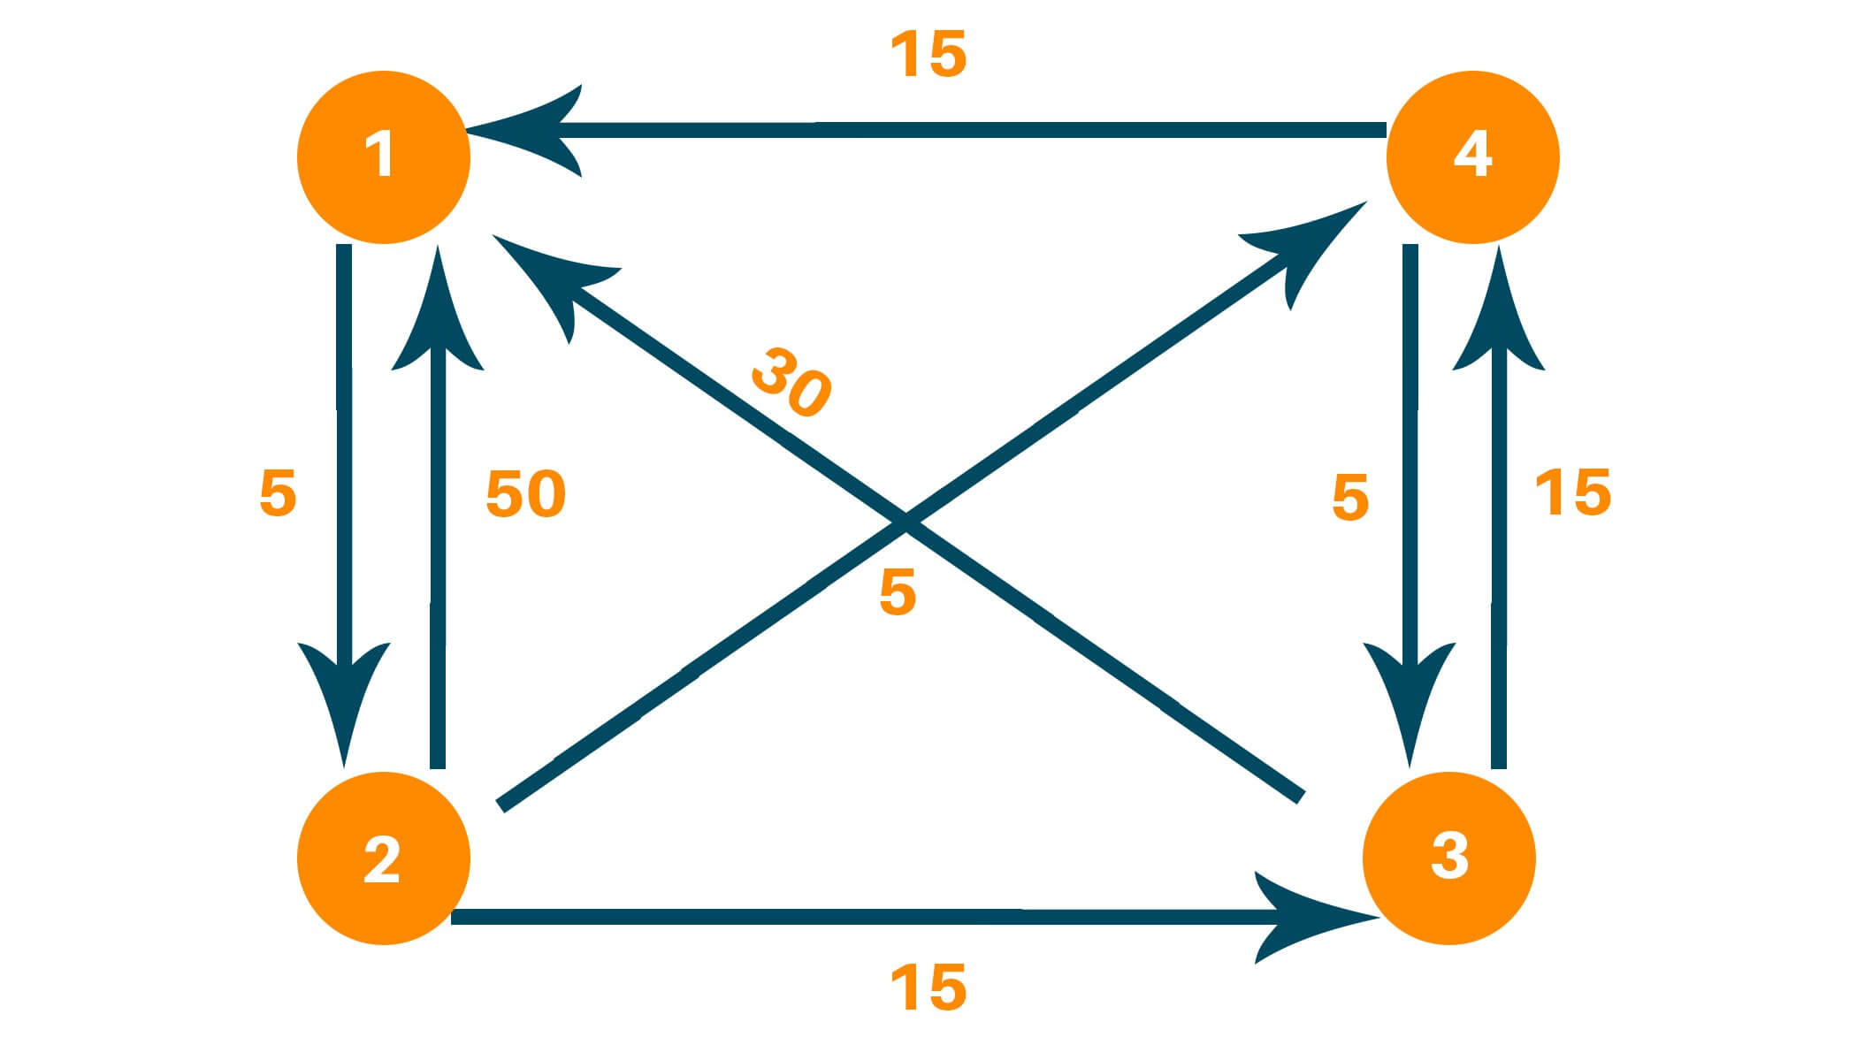
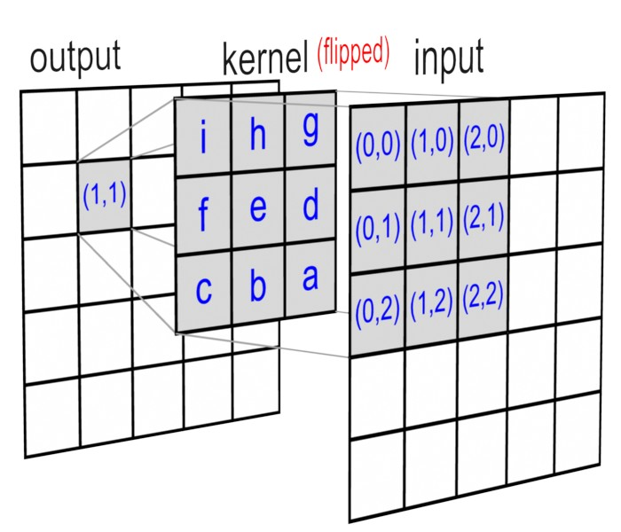
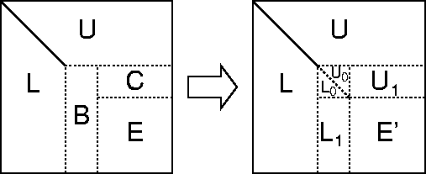
optimizing tensor computation
Different architectures:
ALU
ALU
ALU
ALU
ALU
Cache
Cache
Cache
Memory
Memory
Memory
Shared-memory
Multi-node cluster
Single core CPU
Multi-core CPU
Different tensor computations:
Matmul
All-pairs-shortest-paths
Convolution
LU decomposition
We extend the modeling method to optimize more types of tensor computation on different types of architectures
Notes:
we will show that our method can be extentd to support diff arch and more genral comp, shared-mem and dist-mem, and analyze more complex computations beyond conv

Slide 8
Design Space for Vertical memory hierarchy
Key challenge: enormous space of tile sizes & loop permutations
${(7!)}^{L}$ permutations; 7*L tile-size variables
Memory
7! Permutations
7 tile-size vars
Data movement
Loop order & tile-sizes determine data movement volume between memory and cache
Cache
7! Permutations
7 tile-size vars
Data movement
Loop order & tile-sizes determine data movement volume between cache and register
register
Notes:
We now look back to our conv example. For this vertical mem hier, the main problem we want to overcome is the design space explosion over both the permu and tsize.
We can solve them in two parts

Slide 9
Overcoming design space explosion
Enormous space of {tile loop permutations} x {tile sizes}
Tile loop permutation choices:
Analytical modeling to prune many permutations with provably higher/equal data movement
Tile size choice:
Formulate and solve constrained non-linear optimization problem
Generate Pruned Tiled Loop Permutations
Form Constrained Nonlinear Programming Problem
Solve with Off-the-shelf Solver (IPOPT)
Notes:
in order to overcome the permutation explosion, we found that under the analytical cost model, serveral diff permu will have higher/equal dm that others. This provide possiblity of pruning
in order to overcome the tsz explosion, we will translate the code opt problem as a NLP

Slide 10
System overview
Stage 1: Modeling & pruning
Modeling data volume in analytical expression
Pruning to eliminate design space explosion
Stage 2: Solving machinery
Find the solution of the modelled problem
Stage 3: Code generation
Parallelism, SIMD, etc.
Notes:
our can be summarized as 3 stage
..
we will starts from intro our statg 1

Slide 11
data volume ModELing: Matrix multiplication
Dv=NiNj+NiNk*Nj/Tj+NjNk*Ni/Ti
Not in cache;
Reload for tj
Tk
Atile
Atile
Ctile
A
C
Dv=TiNj+TiNk*Nj/Tj+NjNk
Ti
Ctile
For ti = 0:Ni:Ti
For tj = 0:Nj:Tj
For tk = 0:Nk:Tk
For pi = 0:Ti:1
For pj = 0:Tj:1
For pk = 0:Tk:1
C[ti+pi, tj+pj] +=
A[ti+pi, tk+pk]*
B[tj+pj, tk+pk];
Ctile
Ctile
Atile
Atile
i:[0:Ni)
Dv=TiTj+TiNk+TjNk
k: [0:Nk)
j:[0:Nj)
Tj
Dv=TiTj+TiTk+TjTk
B
Tk
Btile
Btile
Tk
k
Not in cache,
Reload for ti
Btile
Btile
Ni, Nj, Nk: Larger than cache capacity
Ti, Tj, Tk: Large enough to not waste cache capacity
Notes:
for illustration purpose, we use matmul as example.
In this eg we present a 1-lv tiling code runing on vertical mem system with 1 cache. For clearance we assume the problem size of matrices are much larger than cache size, and tile size are not too small to waste the cache capacity. The cost analysis starts form bottom to top
At first step we highlight

Slide 12

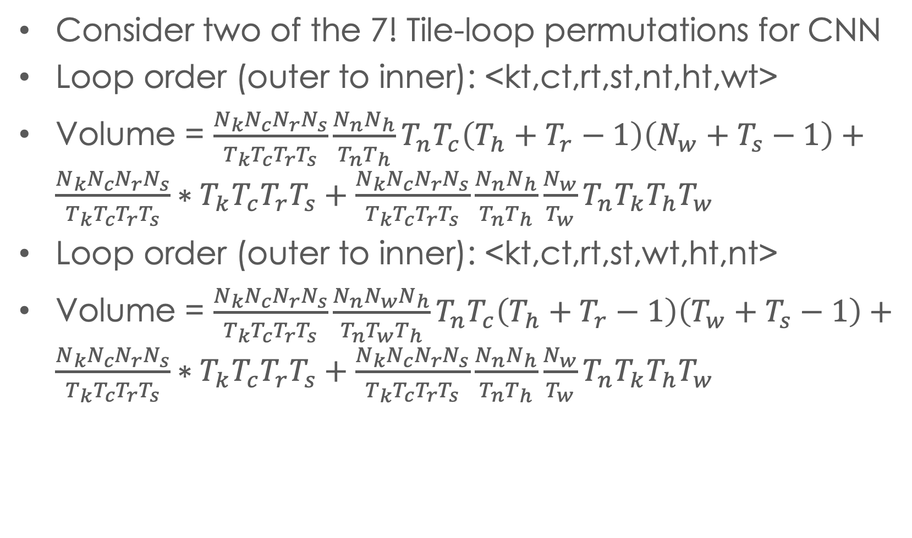
Pruning Tile permutations
Loop order < kt,ct,rt,st,wt,ht,nt >
can never be better than < kt,ct,rt,st,nt,ht,wt >
Consider two of the 7! Tile-loop permutations for CNN
Loop order (outer to inner): <kt,ct,rt,st,nt,ht,wt>
Volume = ${\frac{N_{k}N_{c}N_{r}N_{s}}{T_{k}T_{c}T_{r}T_{s}}\frac{N_{n}N_{h}}{T_{n}T_{h}}T}_{n}T_{c}\left(T_{h}+T_{r}−1\right)\left(N_{w}+T_{s}−1\right)+\frac{N_{k}N_{c}N_{r}N_{s}}{T_{k}T_{c}T_{r}T_{s}}∗T_{k}T_{c}T_{r}T_{s}+\frac{N_{k}N_{c}N_{r}N_{s}}{T_{k}T_{c}T_{r}T_{s}}\frac{N_{n}N_{h}}{T_{n}T_{h}}\frac{N_{w}}{T_{w}}T_{n}T_{k}T_{h}T_{w}$
Loop order (outer to inner): <kt,ct,rt,st,wt,ht,nt>
Volume = ${\frac{N_{k}N_{c}N_{r}N_{s}}{T_{k}T_{c}T_{r}T_{s}}\frac{N_{n}N_{w}N_{h}}{T_{n}T_{w}T_{h}}T}_{n}T_{c}\left(T_{h}+T_{r}−1\right)\left(T_{w}+T_{s}−1\right)+\frac{N_{k}N_{c}N_{r}N_{s}}{T_{k}T_{c}T_{r}T_{s}}∗T_{k}T_{c}T_{r}T_{s}+\frac{N_{k}N_{c}N_{r}N_{s}}{T_{k}T_{c}T_{r}T_{s}}\frac{N_{n}N_{h}}{T_{n}T_{h}}\frac{N_{w}}{T_{w}}T_{n}T_{k}T_{h}T_{w}$
$$\left(N_{w}+T_{s}−1\right)≤\frac{N_{w}}{T_{w}}(T_{w}+T_{s}−1)$$
Notes:
for a given loop permu, we can infer.
for another... we can also
now if we compare these 2 expr
...
we further simplif the compariosn and obtain..
..
By use this tech, we conclude that

Slide 13
Pruning results
All 7! permutations cannot be better than the following 8 equivalent classes of permutations
⟨{kt, ct, rt, st }, {nt, ht }, wt⟩
⟨{nt, kt, ht, wt }, {ct,rt }, st⟩
⟨{nt,ct, ht, rt, st }, wt, kt⟩
⟨{nt,ct, ht, wt, rt }, st, kt⟩
⟨{kt, ct, rt, st }, {nt, wt }, ht⟩
⟨{nt, kt, ht, wt }, {ct, st }, rt⟩
⟨{nt, ct, wt, rt, st }, ht, kt⟩
⟨{nt, ct, ht, wt, st },rt, kt⟩
(from left to right is from outer loop to inner)
Repermute loop order inside curly brackets does not change data volume expression
Notes:
we need to mention in our slides, the curly bracket indicates repermuting iterators inside
Till here we have demon ..
we will move to how to formalize the optimization problem using the model and how to solve it

Slide 14
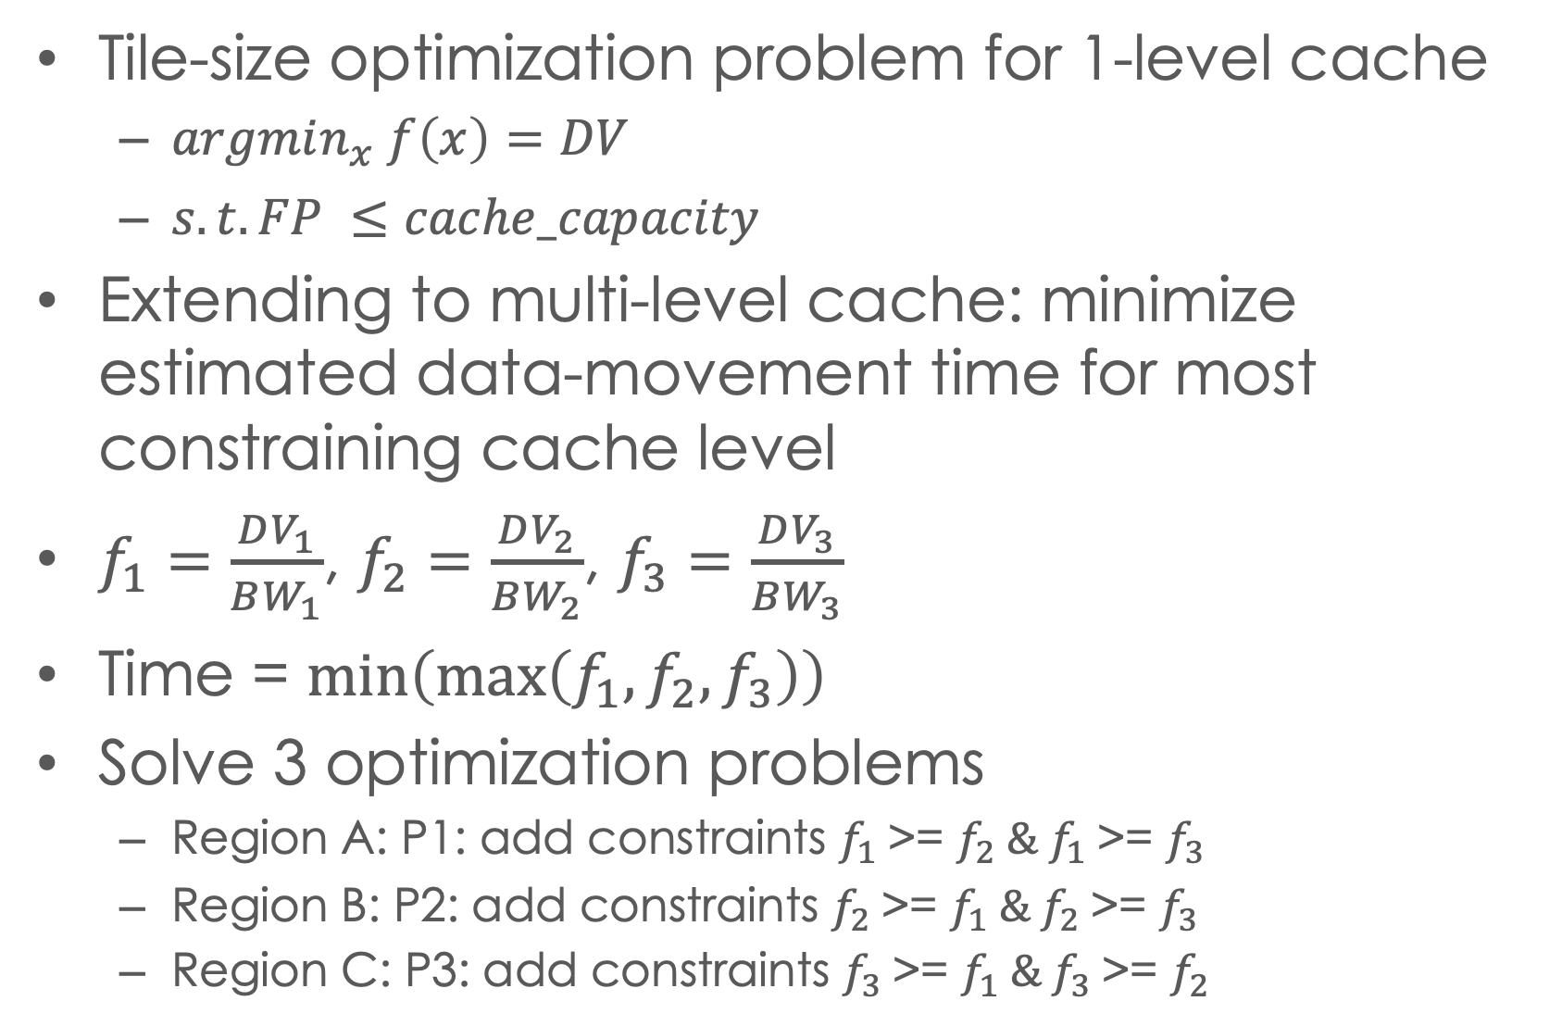
Minimizing cost: multi-level cache
Tile-size optimization problem for 1-level cache
$argmin_{x} f\left(x\right)=DV$
$s.t. FP ≤cache_capacity$
Extending to multi-level cache: minimize estimated data-movement time for most constraining cache level
$f_{1}=\frac{DV_{1}}{BW_{1}}$, $f_{2}=\frac{DV_{2}}{BW_{2}}$, $f_{3}=\frac{DV_{3}}{BW_{3}}$
Time = $\min\left(\max\left(f_{1},f_{2},f_{3}\right)\right)$
Solve 3 optimization problems
Region A: P1: add constraints $f_{1}$>= $f_{2} \&{ f}_{1} \text{>=} f_{3}$
Region B: P2: add constraints $f_{2}$>= $f_{1} \&{ f}_{2} \text{>=} f_{3}$
Region C: P3: add constraints $f_{3}$>= $f_{1} \&{ f}_{3} \text{>=} f_{2}$
Notes:
we can plot those f to get better view.
the perf of system is always limited by the slowest component.
We will then move to the nxet stage to briefly discuss how to codegen

Slide 15
optimizing tensor computation
Different architectures:
ALU
ALU
ALU
ALU
ALU
Cache
Cache
Cache
Memory
Memory
Memory
Shared-memory
Multi-node cluster
Single core CPU
Multi-core CPU
Different tensor computations:
Matmul
All-pairs-shortest-paths
Convolution
LU decomposition
We extend the modeling method to optimize more types of tensor computation on different types of architectures
Notes:
we will show that our method can be extentd to support multi arch, such as shared-mem and dist-mem, and analyze more complex computations beyond conv

Slide 16
Extension to shared-memory
Shared-memory parallelism
Divide the shared-cache into chucks
Each chunk reserved by a single core
Model per-core cost as if each chunk is a independent cache
Model memory cost using the whole shared-cache
Apply time-based modeling
L2 tile
L2 tile
Time L3 to L2
L3 tile
Per-core L3 tile
Per-core L3 tile
Time memory to L3
memory
Notes:
there are sveral important factors, 1. parallel 2. use microkenerl to ensure the inst lv perf

Slide 17
Experimental evaluation
Benchmarks:
All conv2d layers from ResNet, MobileNet, and Yolo-9000
32 conv2ds of various sizes
Platforms:
8-core i7-9700K with AVX2,
18-core i9-10980XE with AVX512
Performance comparison
oneDNN: Intel’s highly optimized library
AutoTVM: ML-based autotuning compiler
Mopt-1: Best-predicted configuration per the model
Mopt-5: Best among the top-5 configurations per model

Slide 18
ExperimentAL performance evaluation
Parallel conv2d performance comparison on Intel 18-core i9-10980XE
Mopt-1 generally close to Mopt-5; some exceptions
Good improvement overall over AutoTVM
Generally comparable or better than oneDNN

Slide 19
Model validation
Generated 100 tiled configurations
Compared run-times for model-predicted best versus actual best among all 100 configurations
Percentage loss-of-performance:
100*(runtime_{ModelBest} – runtime_{ActualBest})/runtime_{ActualBest}

Slide 20
Model integration in tvm compiler
AutoTVM: optimization driven by autotuning
Compile & Run consumes large amount of time and machine resources
Not capable for slow devices/ device in high-demand
TVM driven by static performance model
Full network achieve >90% performance vs. exhaustive autotuned network , but speed up tuning time >50x
Optimizing TF SSD MobileNet on AWS Graviton ARM: 3h vs 240h
For AWS EC2 users, save 90% tunning budget
EC2 expense for allocating Graviton ARM: $12.24 vs $147.84
Allow optimizing code on idle architectures
Use idle x86 servers to find efficient optimization configuration for ARM)
Not stall for slow device / device temporary unavailable

Slide 21
optimizing tensor computation
Different architectures:
ALU
ALU
ALU
ALU
ALU
Cache
Cache
Cache
Memory
Memory
Memory
Shared-memory
Multi-node cluster
Single core CPU
Multi-core CPU
Different tensor computations:
Matmul
All-pairs-shortest-paths
Convolution
LU decomposition
We extend the modeling method to optimize more types of tensor computation on different types of architectures
Notes:
we will show that our method can be extentd to support multi arch, such as shared-mem and dist-mem, and analyze more complex computations beyond conv

Slide 22
Optimizing communication: distributed cnn
Larger design space than shared-memory optimization
Data placement and communication schedules
But structure of array indexing patterns in CNN enables a two-step optimization approach
Formulate and solve a 2-level ”global-memory” parallel tile optimization problem
Translate global-memory solution to a distributed-memory solution

Slide 23
Overview: Global-Memory optimization
Formulate solve 2-lv opt problem, work partition + data tile
solving the programming problem to opt the vol of global-mem
Translate to dist mem
2-level tiling
Outer level of tiling: partition iteration space into P equal “work-partitions” (W-tile) of parametric size W_{i},W_{j},W_{k}, one per processor
Inner level of tiling: Each W-tile is executed as a sequence of memory-constrained tiles of parametric size T_{i},T_{j},T_{k}
Blue: full iteration space (parameter N)
Green: Work-partition for a single processor (variable W)
Orange: Tiling of iteration space of a single processor (variable T)
Data footprint of a tile (orange) must fit in local memory M of a processor
Optimization problem: Find W, T to minimize communication cost from “global memory” to each processor

Slide 24
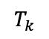
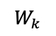
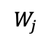
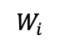
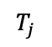
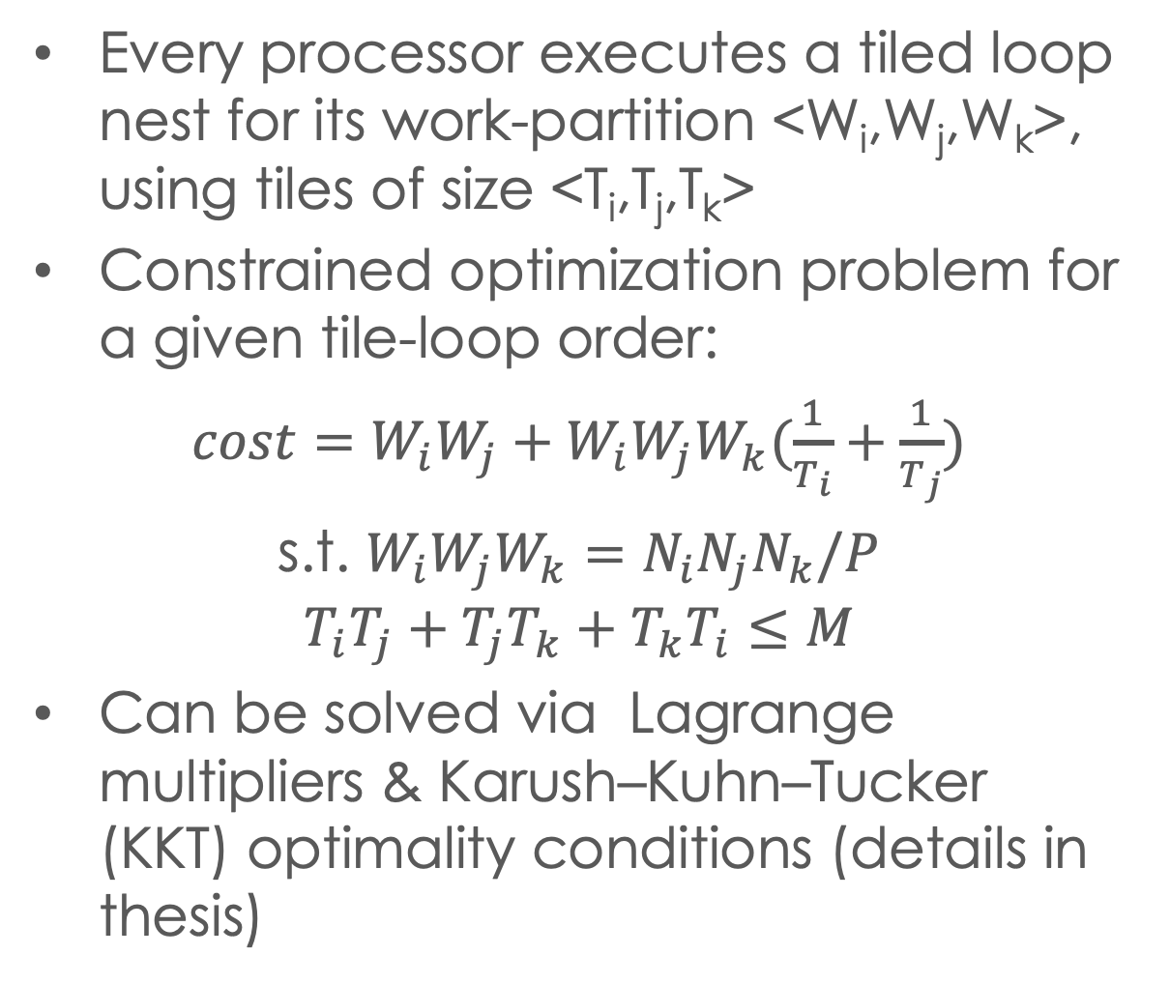
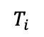
Global-memory optimization
Every processor executes a tiled loop nest for its work-partition <W_{i},W_{j},W_{k}>, using tiles of size <T_{i},T_{j},T_{k}>
Constrained optimization problem for a given tile-loop order:
$cost=W_{i}W_{j}+W_{i}W_{j}W_{k}(\frac{1}{T_{i}}+\frac{1}{T_{j}})$
s.t. $W_{i}W_{j}W_{k}=N_{i}N_{j}N_{k}/P$
$$T_{i}T_{j}+T_{j}T_{k}+T_{k}T_{i}≤M$$
Can be solved via Lagrange multipliers & Karush–Kuhn–Tucker (KKT) optimality conditions (details in thesis)
$$T_{k}$$
$$T_{i}$$
$$T_{j}$$
$$W_{k}$$
$$W_{j}$$
$$W_{i}$$
for ti over Wi step Ti
for tj over Wj step Tj
for tk over Wk step Tk
Tile(ti,tj,tk)
Notes:
based on that we can quickly write a simple implementation of conv2d
operator, and we'll demonstrate why it is necessary to optimize this code instead of using it directly.
this simple implementation includes 7d loop nest. this will create a large amount of loop iterations and each loop iteration will have three different data accesses. if we do not optimize this code those data accesses will create a large amount of memory requests and this will slow down the performance of the system.
to optimize this code, an important question is what is the size of the design exploration space of optimizing the conv2d code.
we consider two different techniques the first technique is repermuting the loop order. that will create seven factorial different code versions.
the second technique is the loop tiling. if we tile each loop once we will create a 14 dimensional loop nest. however that is not enough because the loop tiling structure should match to the architecture specification. we will use an example to show the design exploration space of a two-level cache hierarchy

Slide 25
Matrix multiplication: optimal solution
After considering all tile-loop permutations, optimal solution:
2D
3D
2.5D

Slide 26
Construct distributed memory algorithm
Global memory
Distributed Memory
C
C
replicated
C
B0
B1
B0
B1
C
B0
broadcast
A0
Identical tiles from
global memory
A0
B1
A1
Nj
Nj
broadcast
A0
A1
Nk
Nk
A1
Ni
Ni

Slide 27
CNNs solution summary
Details in: Rui Li et al. “Brief Announcement: Efficient Distributed Algorithms
for Convolutional Neural Networks,” SPAA 2021

Slide 28
optimizing tensor computation
Different architectures:
ALU
ALU
ALU
ALU
ALU
Cache
Cache
Cache
Memory
Memory
Memory
Shared-memory
Multi-node cluster
Single core CPU
Multi-core CPU
Different tensor computations:
Matmul
All-pairs-shortest-paths
Model construction
Convolution
LU decomposition
We extend the modeling method to optimize more types of tensor computation on different types of architectures
Notes:
we will show that our method can be extentd to support multi arch, such as shared-mem and dist-mem, and analyze more complex computations beyond conv

Slide 29
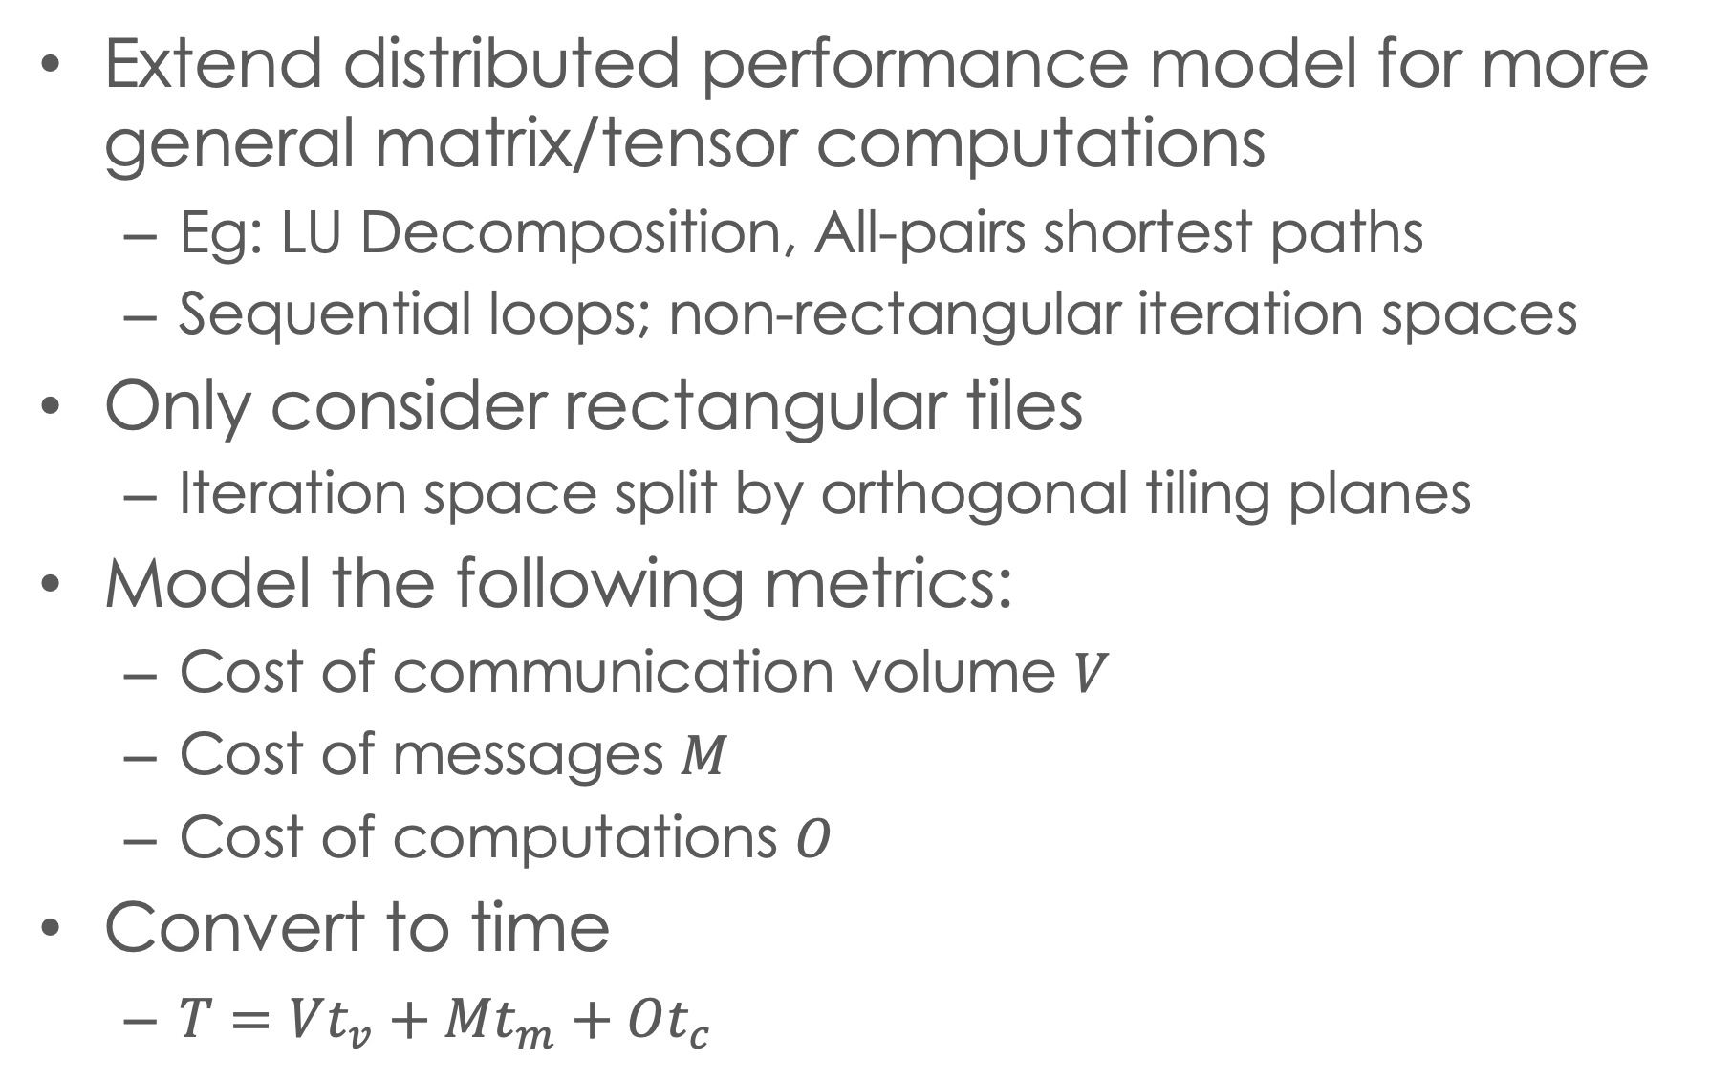
Extension to more general computations
Extend distributed performance model for more general matrix/tensor computations
Eg: LU Decomposition, All-pairs shortest paths
Sequential loops; non-rectangular iteration spaces
Only consider rectangular tiles
Iteration space split by orthogonal tiling planes
Model the following metrics:
Cost of communication volume $V$
Cost of messages $M$
Cost of computations $O$
Convert to time
$T=Vt_{v}+Mt_{m}+Ot_{c}$

Slide 30
Rectangular tile
Use parallel hyperplanes to partition iteration space
j
j
i
i
k
k
Tiling on k
Tiling on i

Slide 31
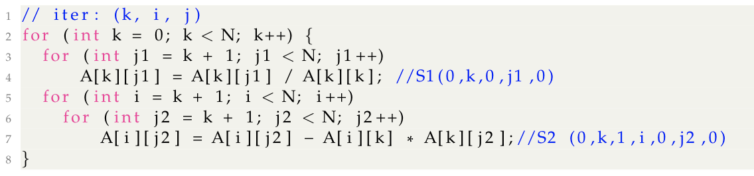
Simplified Lu example
j
Original code:
i
Inter-tile dependence for 1-level tiling:
k
H
W1
k tiling loop is sequential
Tiles along i,j are executed in 4 groups: H, W1, W2, B
B
W2
k tile plane 1
k tile plane 2

Slide 32
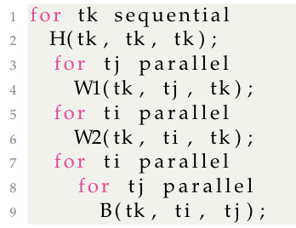
Simplified lu example
Inter-tile dependence,
single k plane
The execution schedule can be described by the imperfect loop nest
H
W1
Inter-tile dependence for 1-level tiling:
W2
H
B
W1
B
W2

Slide 33
Simplified lu example
Tile-to-processor mapping
H(tk, tk, tk) to P(tk%Px, tk%Py)
W1(tk, tj, tk) to P(tk%Px, tj%Py)
W2(ti, tk, tk) to P(ti%Px, tk%Py)
B(ti, tj, tk) to P(ti%Px, tj%Py)
Data-to-processor mapping
A(row, col) to P(row%Px, col%Py)
Owner-computes mapping
Tile and its output data must be mapped to same processor
Inter-tile dependence,
single k plane
H
W1
W2
B
0,0
0,1
1,0
1,1
2D processor grid
(4 processors)

Slide 34
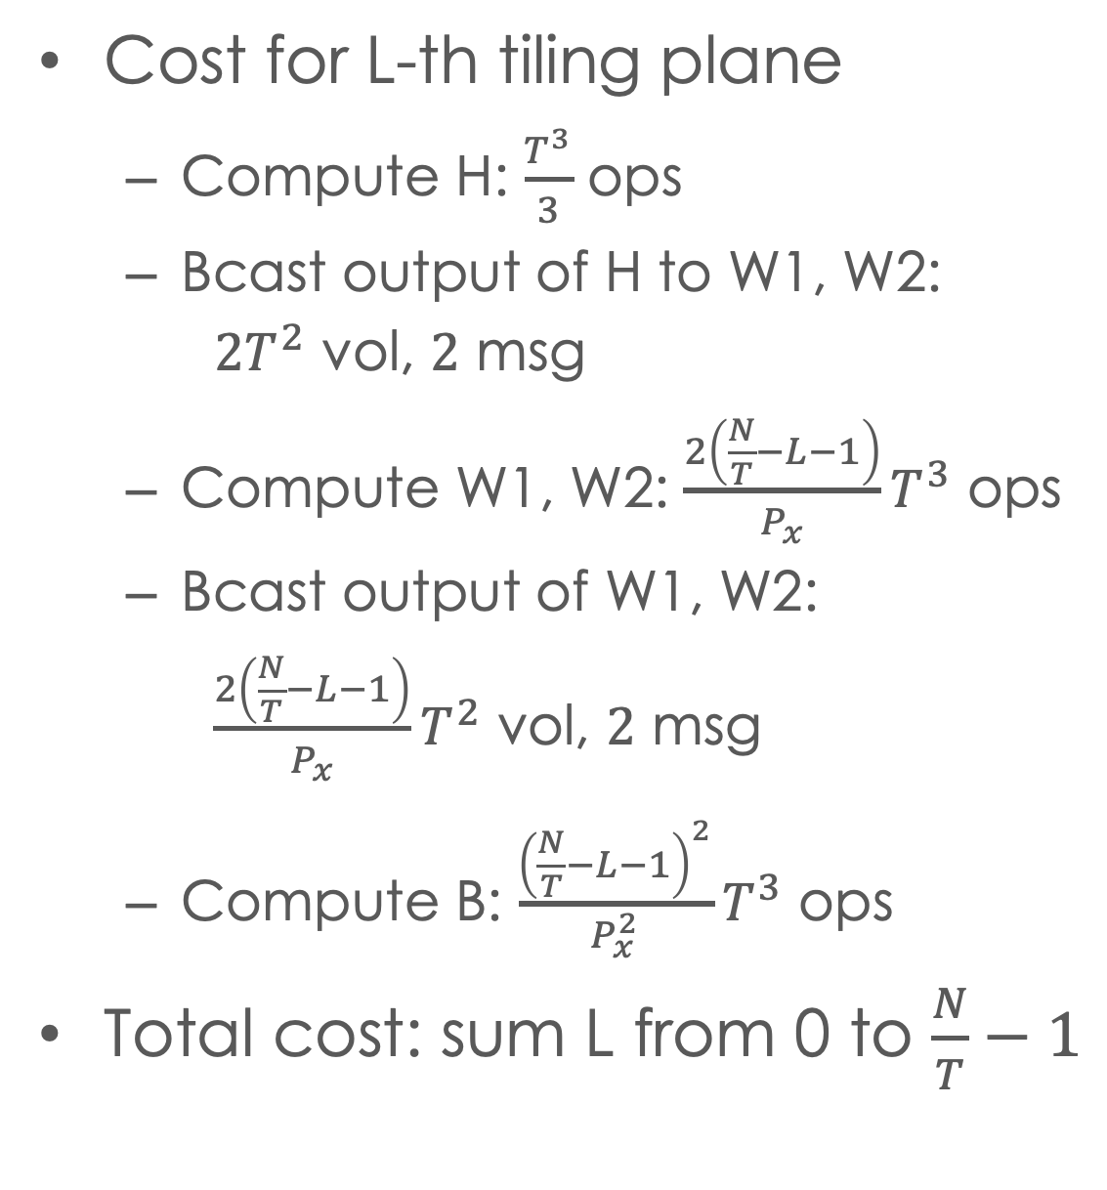
L-th tiling plane along k (tk=L)
Simplified lu example
Cost for L-th tiling plane
Compute H: $\frac{T^{3}}{3}$ ops
Bcast output of H to W1, W2:
${2T}^{2}$ vol, $2$ msg
Compute W1, W2: $\frac{2\left(\frac{N}{T}−L−1\right)}{P_{x}}T^{3}$ ops
Bcast output of W1, W2:
$\frac{2\left(\frac{N}{T}−L−1\right)}{P_{x}}T^{2}$ vol, $2$ msg
Compute B: $\frac{{\left(\frac{N}{T}−L−1\right)}^{2}}{P_{x}^{2}}T^{3}$ ops
Total cost: sum L from 0 to $\frac{N}{T}−1$
(N/T-L-1)*T
T
H
W1
T
W2
B
0,0
0,1
1,0
1,1
2D processor grid
(4 processors)

Slide 35
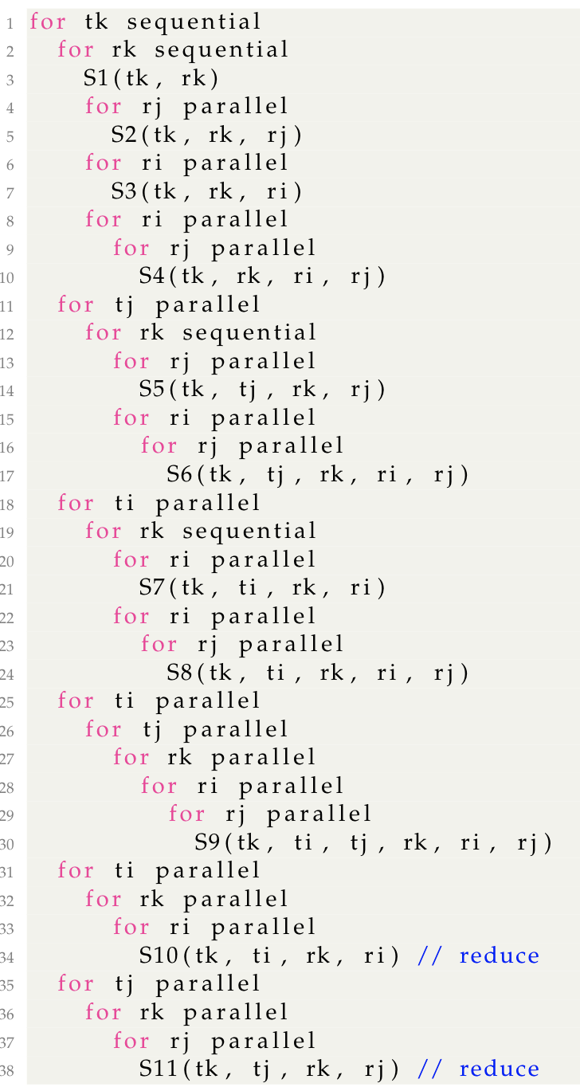
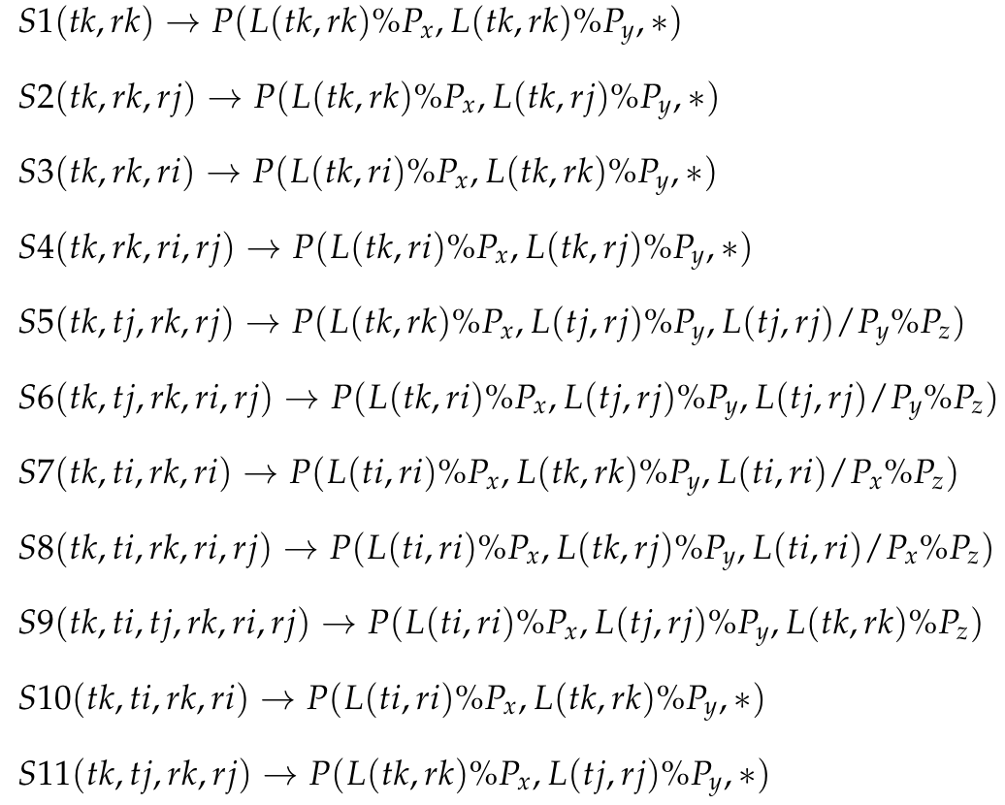
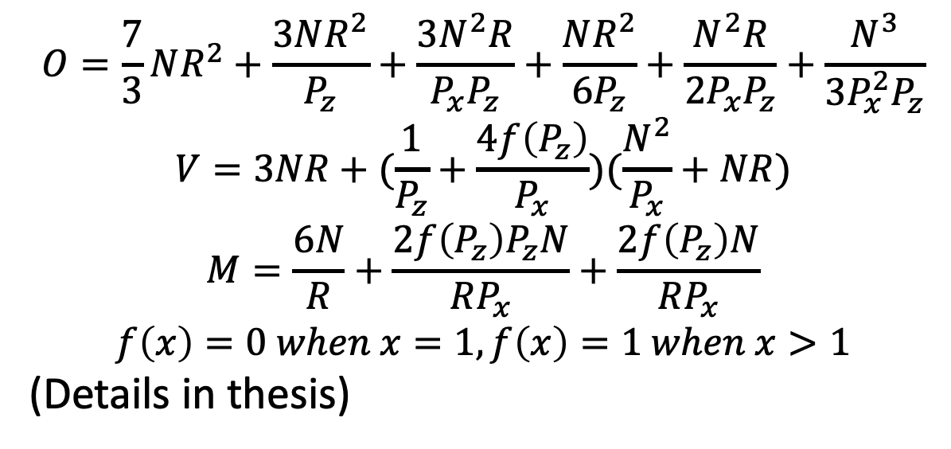
Performance model of 2-level tiling
$$O=\frac{7}{3}NR^{2}+\frac{3NR^{2}}{P_{z}}+\frac{3N^{2}R}{P_{x}P_{z}}+\frac{NR^{2}}{6P_{z}}+\frac{N^{2}R}{2P_{x}P_{z}}+\frac{N^{3}}{3P_{x}^{2}P_{z}}$$
$$V=3NR+(\frac{1}{P_{z}}+\frac{4f\left(P_{z}\right)}{P_{x}})(\frac{N^{2}}{P_{x}}+NR)$$
$$M=\frac{6N}{R}+\frac{2f\left(P_{z}\right)P_{z}N}{RP_{x}}+\frac{2f\left(P_{z}\right)N}{RP_{x}}$$
$$f\left(x\right)=0 when x=1, f\left(x\right)=1 when x>1$$
(Details in thesis)
R
T
R
T
l-th k tiling plane

Slide 36
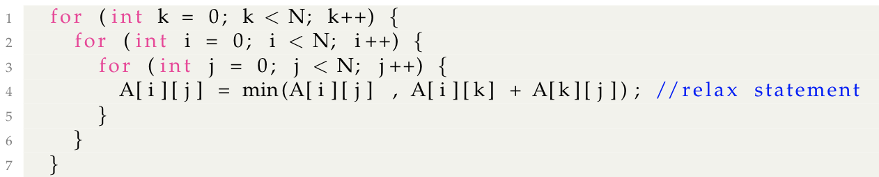
Simplified APSP example
Inter-tile dependence
First k plane
H
W1
Oringial code of APSP
W2
B
3D cube iteration space
3D cone (pyramid) in LU
Tiles groups in crucifix
Groups L-shape in LU
Similar model applies
Use loop schedule and processor mapping to derive the cost expression
Second k plane
W1
H
W2
B

Slide 37
APSP experiment (comparision)
test id | N | Block | px | pz | P
1 | 7680 | 32 | 4 | 1 | 16
2 | 7680 | 32 | 6 | 1 | 36
3 | 7680 | 32 | 8 | 1 | 64
4 | 7680 | 16 | 4 | 1 | 16
5 | 7680 | 16 | 6 | 1 | 36
6 | 7680 | 16 | 8 | 1 | 64
7 | 7680 | 32 | 4 | 2 | 32
8 | 7680 | 32 | 6 | 2 | 72
9 | 7680 | 16 | 4 | 2 | 32
10 | 7680 | 16 | 6 | 2 | 72
11 | 7680 | 32 | 4 | 4 | 64
12 | 7680 | 32 | 6 | 3 | 108
13 | 7680 | 16 | 4 | 4 | 64
14 | 7680 | 16 | 6 | 3 | 108
Test on 4 node, 112 core cluster
Compare with: Solomonik et al. "Minimizing communication in all-pairs shortest paths." IPDPS 2013
Implement 2 different 2-level tiling loop schedule (schedule A/B, details in thesis)
*Solomonik’s algorithm is recursive-based, so it does not work when px is not power of 2

Slide 38
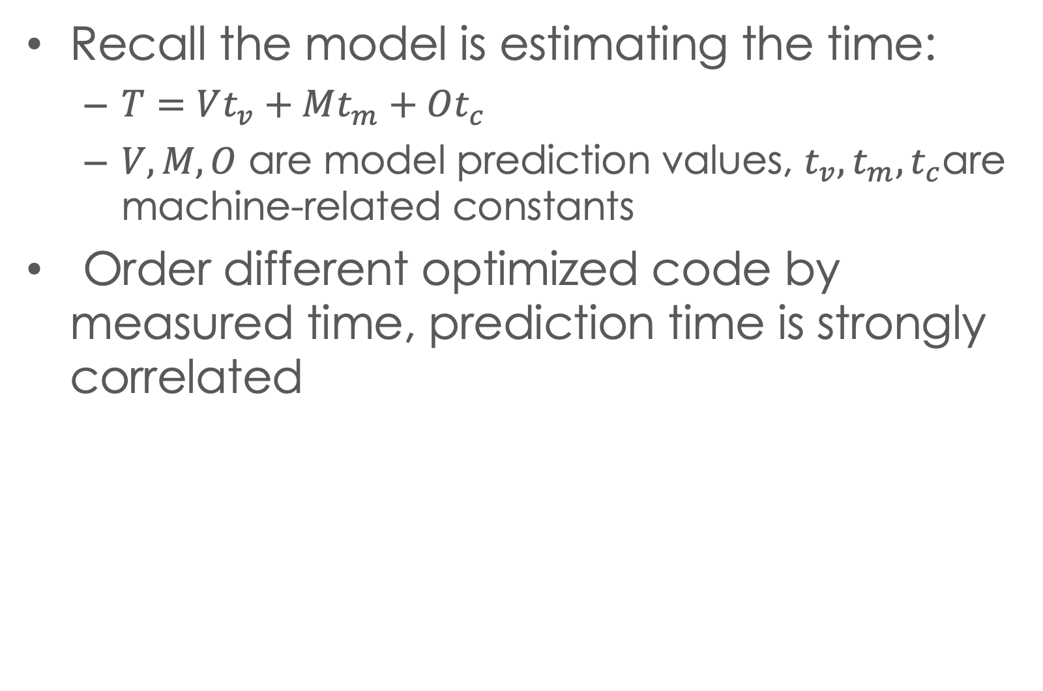
APSP experiment (model validation)
Recall the model is estimating the time:
$T=Vt_{v}+Mt_{m}+Ot_{c}$
$V,M,O$ are model prediction values, $t_{v}, t_{m}, t_{c}$are machine-related constants
Order different optimized code by measured time, prediction time is strongly correlated
*Multiple R: The multiple correlation coefficient, range: -1 to 1
Observation | Predicted Y | Residuals | Percentage | stddev
1 | 14.2478829 | -0.5693029 | -4.00% | 9.28%
2 | 9.46309584 | 0.28559216 | 3.02%
3 | 7.74026984 | -0.9423128 | -12.17%
4 | 14.7857612 | 0.78161575 | 5.29%
5 | 10.0741965 | 0.56335048 | 5.59%
6 | 8.38798168 | -0.8022487 | -9.56%
7 | 9.34837852 | 0.89622048 | 9.59%
8 | 6.78418612 | 0.64201888 | 9.46%
9 | 10.1164905 | 0.81645749 | 8.07%
10 | 7.54877589 | 0.13049611 | 1.73%
11 | 6.73176667 | 0.16567833 | 2.46%
12 | 5.80246047 | 1.41109853 | 24.32%
13 | 7.56683541 | 0.19138359 | 2.53%
14 | 6.56470208 | 0.81164492 | 12.36%
15 | 11.8245743 | -1.2090393 | -10.22%
16 | 7.1451163 | -0.1341003 | -1.88%
17 | 5.47495481 | -0.5696898 | -10.41%
18 | 11.8784672 | 0.80770484 | 6.80%
19 | 7.24364697 | 0.84219103 | 11.63%
20 | 5.5958044 | -0.1123684 | -2.01%
21 | 8.86737091 | -1.1996989 | -13.53%
22 | 6.24851105 | -0.293128 | -4.69%
23 | 9.5661412 | -0.4635512 | -4.85%
24 | 6.96960026 | -0.3266693 | -4.69%
25 | 7.0821929 | -0.0585699 | -0.83%
26 | 5.77408864 | 0.24082736 | 4.17%
27 | 8.19972204 | -1.050763 | -12.81%
28 | 6.70269736 | -0.8548374 | -12.75%
Regression Statistics
Multiple R | 0.95855574
R Square | 0.9188291
Adjusted R Square | 0.90868273
Standard Error | 0.77460377
Observations | 28

Slide 39
optimizing tensor computation
Different architectures:
ALU
ALU
ALU
ALU
ALU
Cache
Cache
Cache
Memory
Memory
Memory
Shared-memory
Multi-node cluster
Single core CPU
Multi-core CPU
Different tensor computations:
Matmul
All-pairs-shortest-paths
Convolution
LU decomposition
We extend the modeling method to optimize more types of tensor computation on different types of architectures
Notes:
we will show that our method can be extentd to support multi arch, such as shared-mem and dist-mem, and analyze more complex computations beyond conv

Slide 40
Thanks for listening
Questions ?

Slide 41
Outline
Performance model and design space exploration for basic tensor operators on single core, vertical memory hierarchy
Key idea of modeling and exploration
Automatic solution derivation
Extension to shared-memory architecture
Extension to distributed memory cluster
Extension to more complex tensor computation on distributed memory cluster
Notes:
We will keep using the vertical memory and simple tc example to illustrate the main idea, and introduce how to make extensions

Slide 42
Using model in deep learning compiler
AutoTVM compiler uses auto-tuning to evaluate the performance of different optimization
Huge time and resource consumption
Online tunning must be deployed on target machine
Extra difficulties for deployment
Next generation AutoTVM
Remove auto-tuning, use static-analysis based performance model to evaluate performance
Use same idea to model data movement
Other features included
Production project completed in internship in AWS SageMaker/TVM team

Slide 43
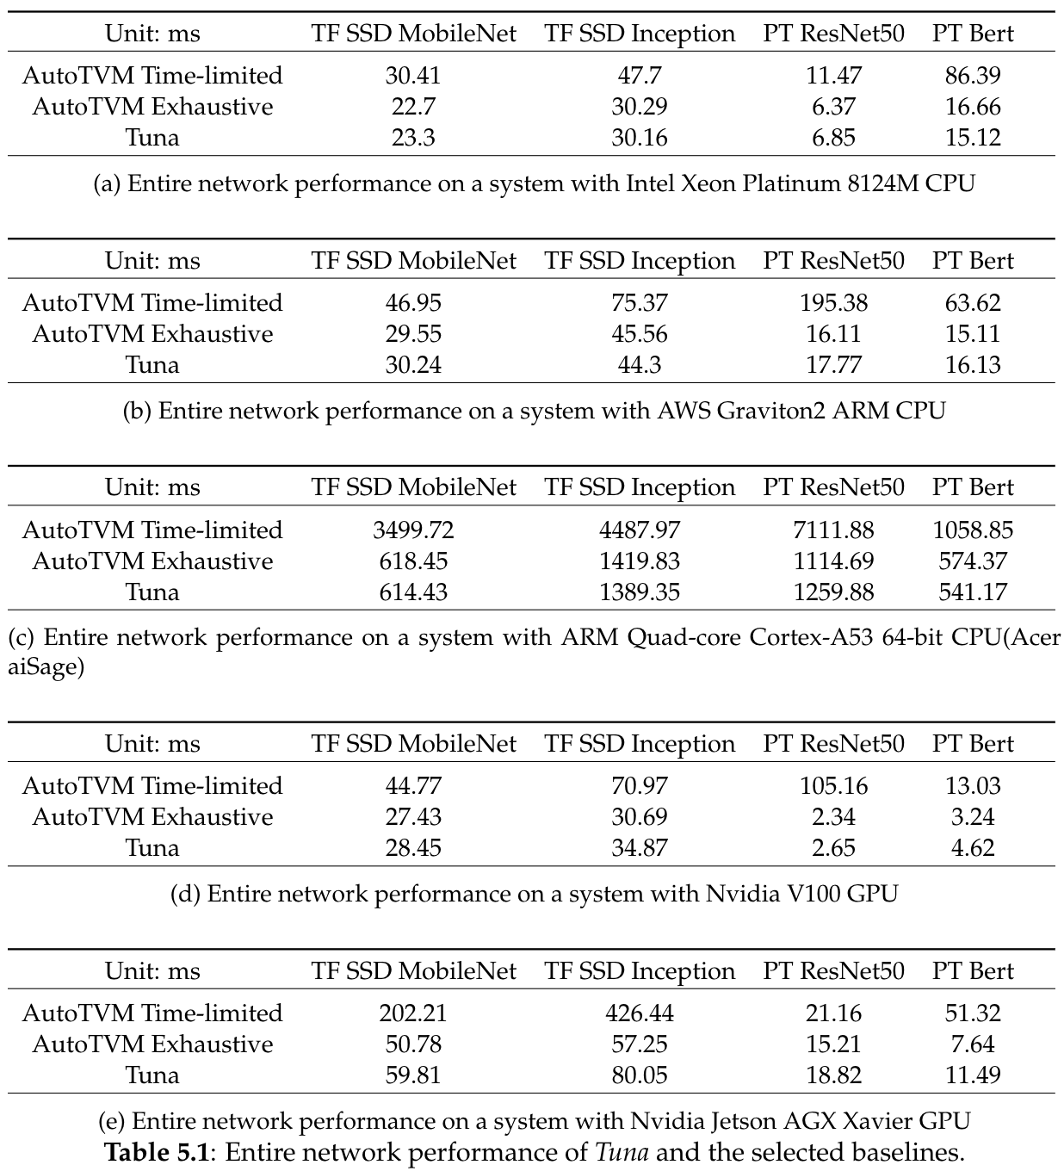
Using model in deep learning compiler
Table shows inference time
AutoTVM Time-limited: auto-tunning under time limitation
AutoTVM Exhaustive: exhaustively auto-tunning (time consumption shown in next page)
Tuna: model-driven TVM
1.3x ~ 5.7x faster than limited-time tuning, comparable with exhaustive tuning

Slide 44
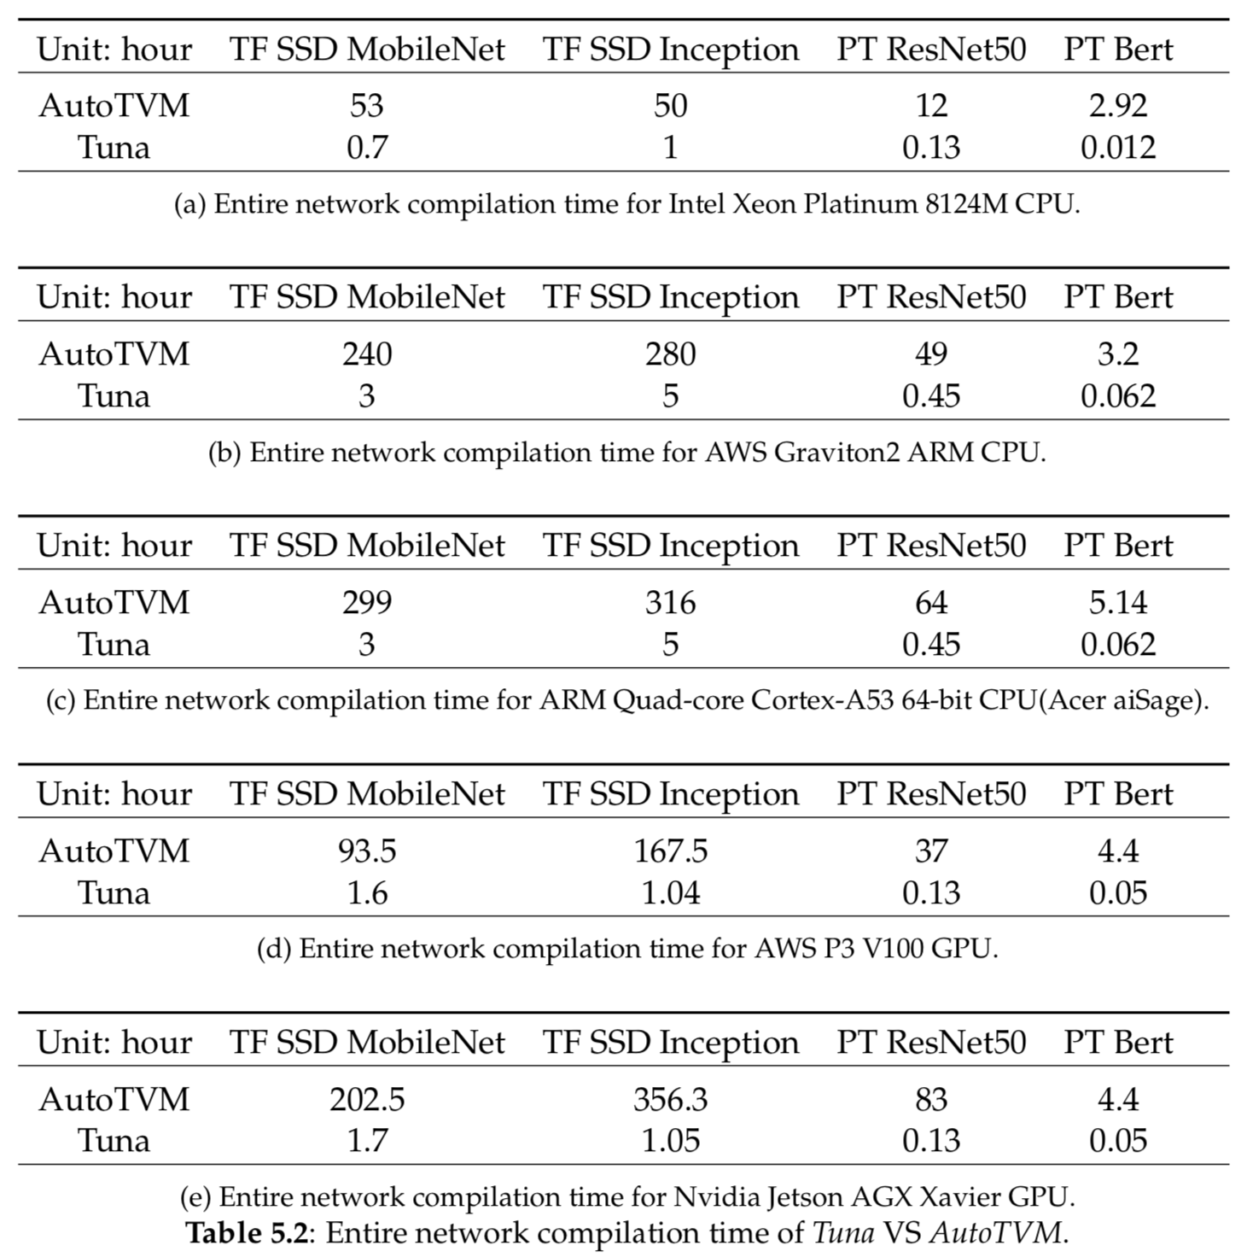
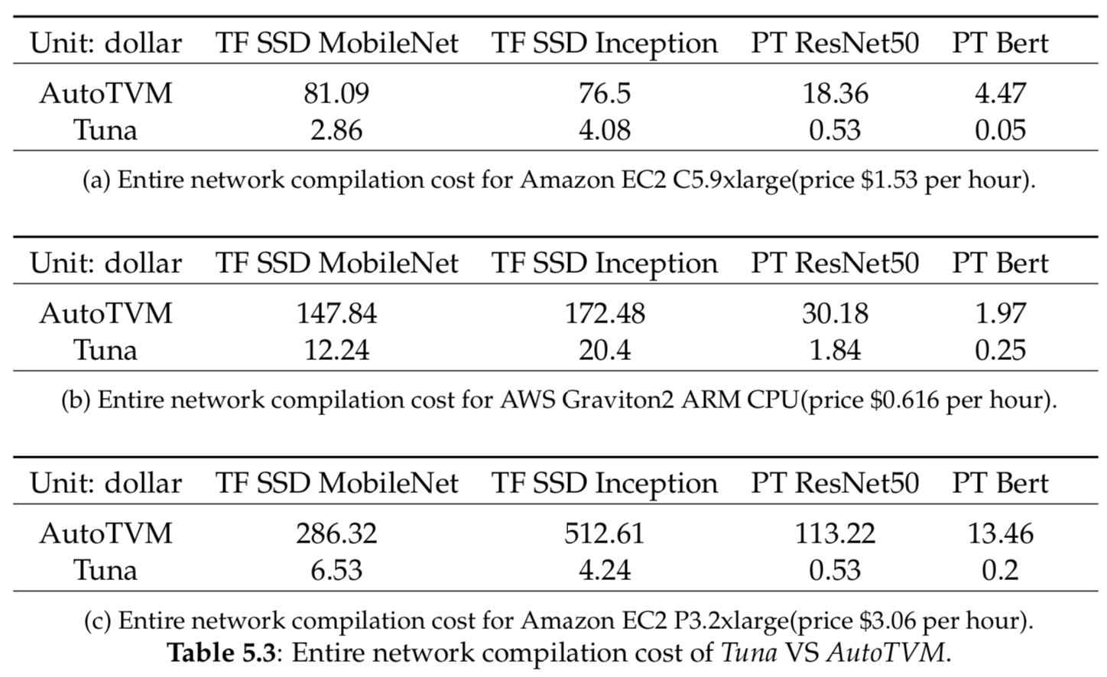
Using model in deep learning compiler
Tuning time comparison versus exhaustive auto-tuning
Always faster than limited-time tuning, comparable with exhaustive tuning
Accelerate tunning time >80x to find same efficient optimization
User save >95% expense for renting AWS EC2 instances in ML service

Slide 45
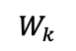
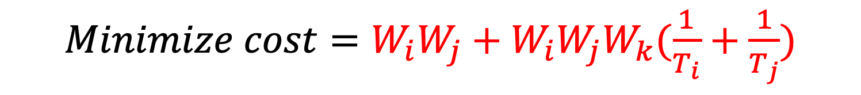
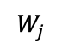
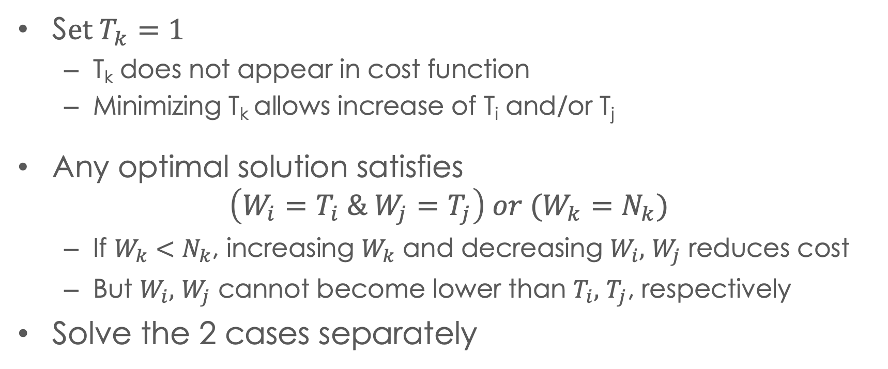
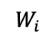
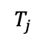

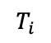

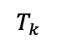
Matrix multiplication: optimization
$Minimize cost=W_{i}W_{j}+W_{i}W_{j}W_{k}(\frac{1}{T_{i}}+\frac{1}{T_{j}})$
s.t. $W_{i}W_{j}W_{k}=N_{i}N_{j}N_{k}/P$
$$T_{k}$$
$$T_{i}T_{j}+T_{j}T_{k}+T_{k}T_{i}≤M$$
$$T_{i}$$
$$T_{j}$$
$$W_{k}$$
$$W_{j}$$
S$et T_{k}=1$
T_{k} does not appear in cost function
Minimizing T_{k} allows increase of T_{i} and/or T_{j}
Any optimal solution satisfies
$$\left(W_{i}=T_{i} \& W_{j}=T_{j}\right) or (W_{k}=N_{k})$$
If $W_{k}<N_{k}$, increasing $W_{k}$ and decreasing $W_{i},$ $W_{j}$ reduces cost
But $W_{i},$ $W_{j}$ cannot become lower than $T_{i},$ $T_{j}$, respectively
Solve the 2 cases separately
$$W_{i}$$

Slide 46
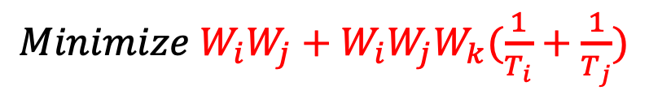
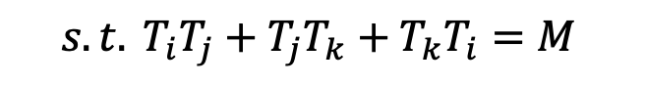
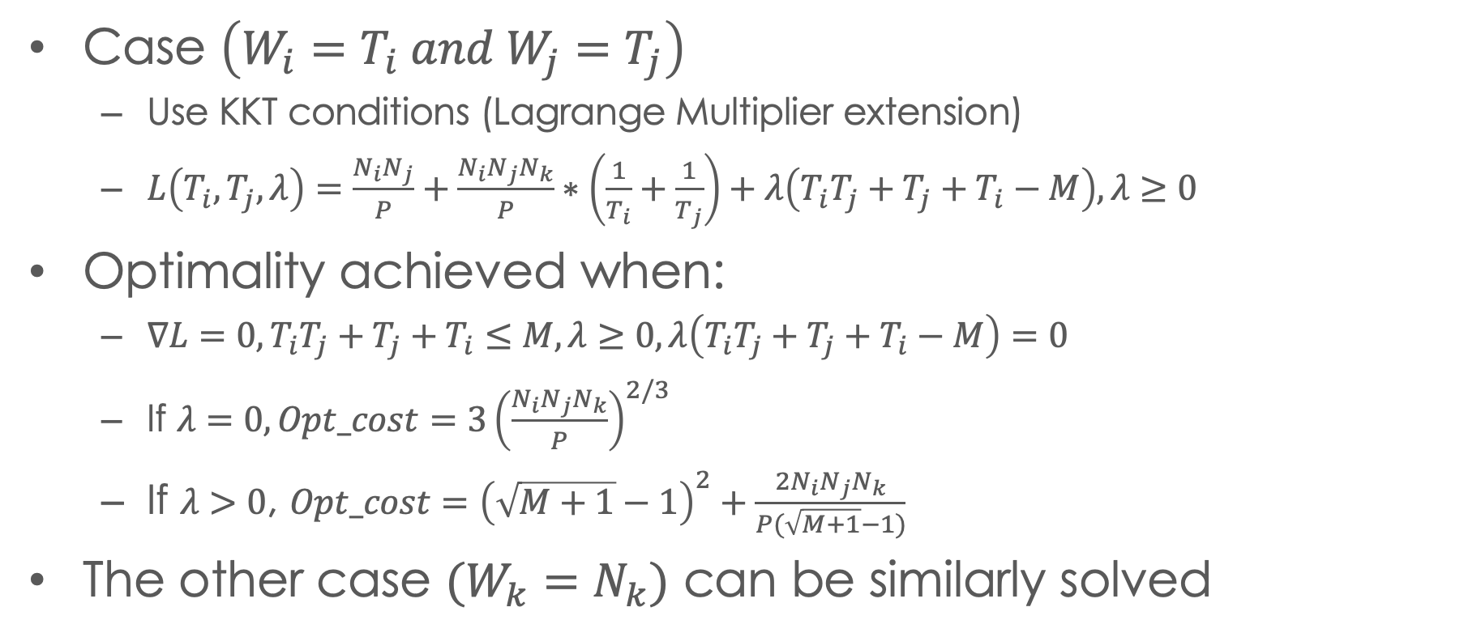
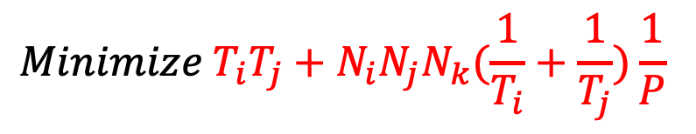
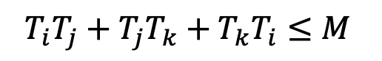
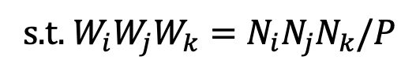
Matrix multiplication: optimal solution
$Minimize W_{i}W_{j}+W_{i}W_{j}W_{k}(\frac{1}{T_{i}}+\frac{1}{T_{j}})$
$$Minimize T_{i}T_{j}+N_{i}N_{j}N_{k}(\frac{1}{T_{i}}+\frac{1}{T_{j}})\frac{1}{P}$$
s.t. $W_{i}W_{j}W_{k}=N_{i}N_{j}N_{k}/P$
$$T_{i}T_{j}+T_{j}T_{k}+T_{k}T_{i}≤M$$
$${s.t. T}_{i}T_{j}+T_{j}T_{k}+T_{k}T_{i}=M$$
Case $\left(W_{i}=T_{i} and W_{j}=T_{j}\right)$
Use KKT conditions (Lagrange Multiplier extension)
$L\left(T_{i}, T_{j}, λ\right)=\frac{N_{i}N_{j}}{P}+\frac{N_{i}N_{j}N_{k}}{P}∗\left(\frac{1}{T_{i}}+\frac{1}{T_{j}}\right)+λ\left(T_{i}T_{j}+T_{j}+T_{i}−M\right), λ≥0$
Optimality achieved when:
$∇L=0,T_{i}T_{j}+T_{j}+T_{i}≤M,λ≥0,λ\left(T_{i}T_{j}+T_{j}+T_{i}−M\right)=0$
If $λ=0, Opt_cost=3{\left(\frac{N_{i}N_{j}N_{k}}{P}\right)}^{2/3}$
If $λ>0$, ${Opt_cost=\left(\sqrt{M+1}−1\right)}^{2}+\frac{2N_{i}N_{j}N_{k}}{P(\sqrt{M+1}−1)}$
The other case $(W_{k}=N_{k})$ can be similarly solved

Slide 47



Optimizing CNN
$${cost=W}_{b}W_{k}W_{w}W_{h}+\frac{W_{k}W_{c}N_{r}N_{s}W_{w}W_{h}W_{b}}{T_{w}T_{h}T_{b}}+\frac{W_{b}W_{c}\left(σ_{w}T_{W}+N_{r}−1\right)\left(σ_{h}T_{h}+N_{s}−1\right)W_{w}W_{h}W_{k}}{T_{w}T_{h}T_{k}}$$
$$mem=\left(σ_{w}T_{W}+N_{r}−1\right)\left(σ_{h}T_{h}+N_{s}−1\right)T_{b}T_{c}+T_{w}T_{h}T_{b}T_{k}+N_{r}N_{s}T_{k}T_{c}≤M$$
Too complex to solve analytically
Transform to the following solvable problem to bound the optimal solution to the original problem
$$cost_{L}=W_{b}W_{k}W_{w}W_{h}+W_{k}W_{c}W_{b}W_{h}W_{w}\left(\frac{N_{r}N_{s}}{T_{b}T_{h}T_{w}}+\frac{σ_{W}σ_{h}}{T_{k}}\right),mem_{L}=T_{b}T_{h}T_{w}T_{k}≤M_{L}$$
$T^{∗}\left(M\right):$optimal tiling that makes $cost_{L}$ optimal for given M
Lower bound: $cost_{L}\left(x\right)≤cost(x)$
Upper bound: find $δ$, $mem (T^{∗}\left(M−δ\right))≤M$, make it valid solution
$δ=\frac{1}{2}\left(3K\left(\sqrt{9K^{2}+4M}−3K\right)\right)$
$K=\sqrt{σ_{w}σ_{h}N_{r}N_{s}}$
$T^{∗}\left(M−δ\right)$, $mem\left(T^{∗}\right)≤M$
valid solution
$T^{∗}\left(M\right)$, $mem\left(T^{∗}\right)>M$

Slide 48

APSP experiment (model validation)
Recall the model is estimating the time:
$T=Vt_{v}+Mt_{m}+Ot_{c}$
$V,M,O$ are model prediction values, $t_{v}, t_{m}, t_{c}$are machine-related constants
??Model is valid if the linear relationship holds between $V,M,O$ and measured time??
Use linear regression to examine
Regression Statistics
Multiple R | 0.95855574
R Square | 0.9188291
Adjusted R Square | 0.90868273
Standard Error | 0.77460377
Observations | 28
*Multiple R: The multiple correlation coefficient, range: -1 to 1

Slide 49


Motivation
Convolutional neural network(CNN): core of many deep learning application
Conv2d: all convolution layers in CNN
$$Out\left[n,k,h,w\right]=\sum_{c,r,s}{(In\left[n,c,h+r,w+s\right)∗Ker[k,c,r,s}])$$
Notes:
Our paper is focusing on optimizing..
...
Based on that we can quickly write a simple implemetaion of conv2d ( show code ), and we will demonstrate why it is not recommend to use this un-opt version

Slide 50

Existing work
Key challenge: enormous space of tiling sizes & loop permutations
L levels of cache contains ${7!}^{L}$ permutations
Each permutation includes 7*L tile-size variable
Current state-of-the-art
Fixed loop schedule library: oneDNN(MKL)
Autotuning & ML-based tuning: AutoTVM
Polyhedral compilers: Pluto
We propose a method that comprehensively analyzes the full design exploration space
Notes:
...
We'll intro our work by first provide an overview

Slide 51
Tileable loop detection
Determine which loops can be tiled by analyzing dependence information
Use time-stamp vector
Loop j is tileable if
For any S1(0,k,0,j1,0)->…-> S1(0,k’,0,j1’,0), j1’>=j1
For any S2(0,k,1,i,0,j2,0)->…->S2(0,k’,1,i’,0,j2’,0), ), j2’>=j2
… can be arbitrary statements
Under this criteria, LU is 3D tileable
Detail inference in thesis proposal

Slide 52
conclusion
We proposed a new approach to find the best configuration for optimizing conv2d
We created an effective analytical modeling approach which is exploited to achieve dramatic space pruning
We demonstrate that achieved performance can be comparable to or better than state-of-the-art
Acknowledgments: This work was supported in part by the U.S. National Science Foundation through awards 1946752, 1919122 and 2018016.

